Slide 1
Task Management App
Presented
by
Dhruv Bansal(2210990271)
Keshav Goel (2210990504)
Dhruv Datta (2210990272)
Garvit Setia (2210990316)
Under the supervision
of
Ms. Parul Gehlot
Mr. Vikas Patel
Chitkara University Institute of Engineering and Technology
Chitkara University, Punjab

Slide 2
Introduction
Problem Statement : In today's fast-paced and dynamic work environment, individuals and teams face challenges in effectively managing tasks, resulting in decreased productivity, missed deadlines, and heightened stress levels. Traditional task management methods, such as pen-and-paper lists or basic digital tools, often lack the features and adaptability required to meet the diverse needs of modern professionals.
Solution:Developing a comprehensive task management app that addresses the above issues by providing a centralized, collaborative, and customizable platform. The app will integrate intelligent prioritization, real-time collaboration, advanced scheduling, and robust analytics to empower individuals and teams to enhance their productivity and achieve their goals effectively...

Slide 3
Motivation of Research
The motivation behind researching and developing an innovative task management app stems from the recognition of the critical role efficient task management plays in modern work environments. Several key motivations drive the need for such research:
Increasing Complexity of Work:
As professional tasks become more intricate and interconnected, individuals and teams face challenges in managing multiple responsibilities simultaneously. A robust task management app can provide the necessary tools to navigate and streamline complex work processes.
Growing Demand for Remote Collaboration:
The rise of remote and distributed workforces highlights the importance of effective collaboration tools. A task management app with advanced collaboration features can facilitate seamless communication, coordination, and information sharing among team members, regardless of their physical location.

Slide 4
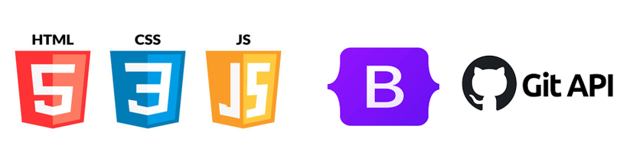
Tools & Technologies
HTML/CSS: For structuring and styling the webpage, ensuring a visually appealing and user-friendly interface.
JavaScript: Implemented for dynamic behavior , functionality and updating content in real-time.
Bootstrap: Utilized for responsive design elements, ensuring compatibility across various devices and screen sizes.
DOM(Document Object Model) : structure of a document as a tree of objects where each object represents a part of the document. These objects can be manipulated programmatically to change the content, structure, and style of a web page.

Slide 5
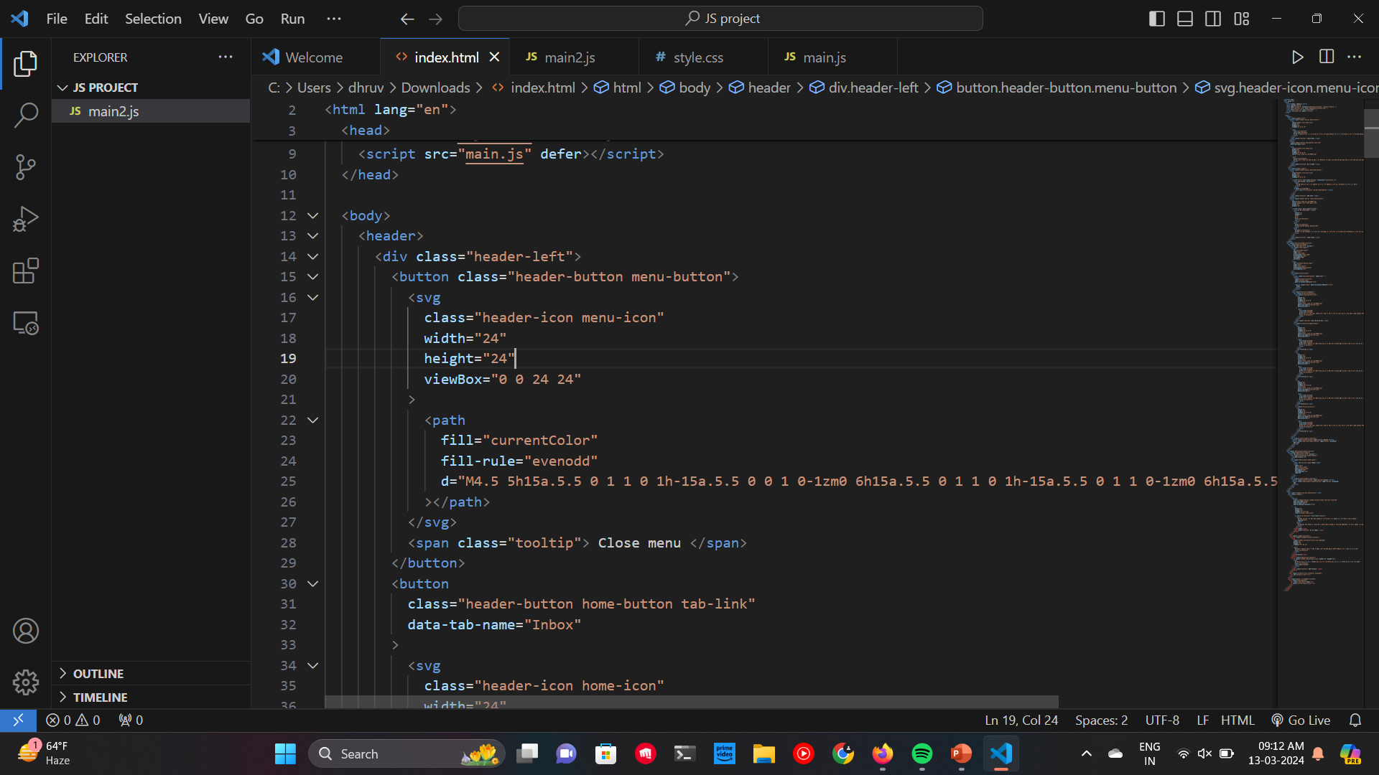
Code Snapshots
1. Html file of landing page

Slide 6
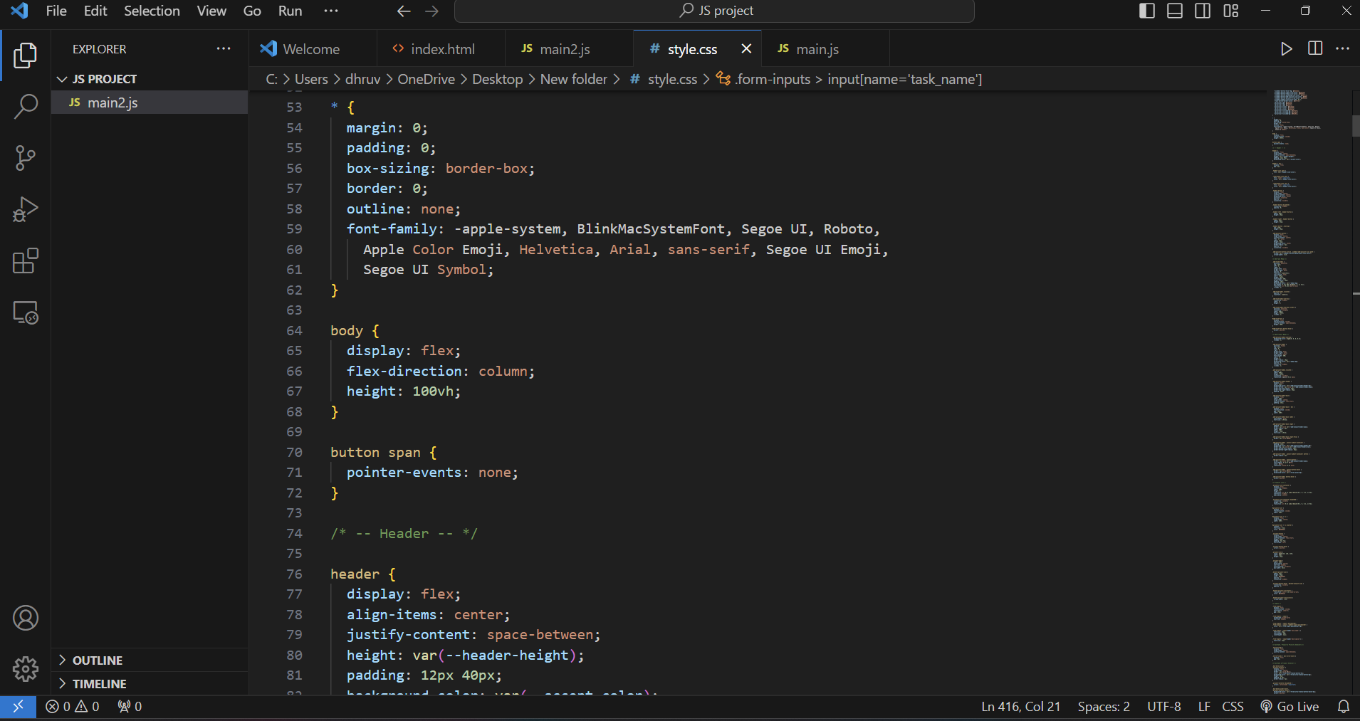
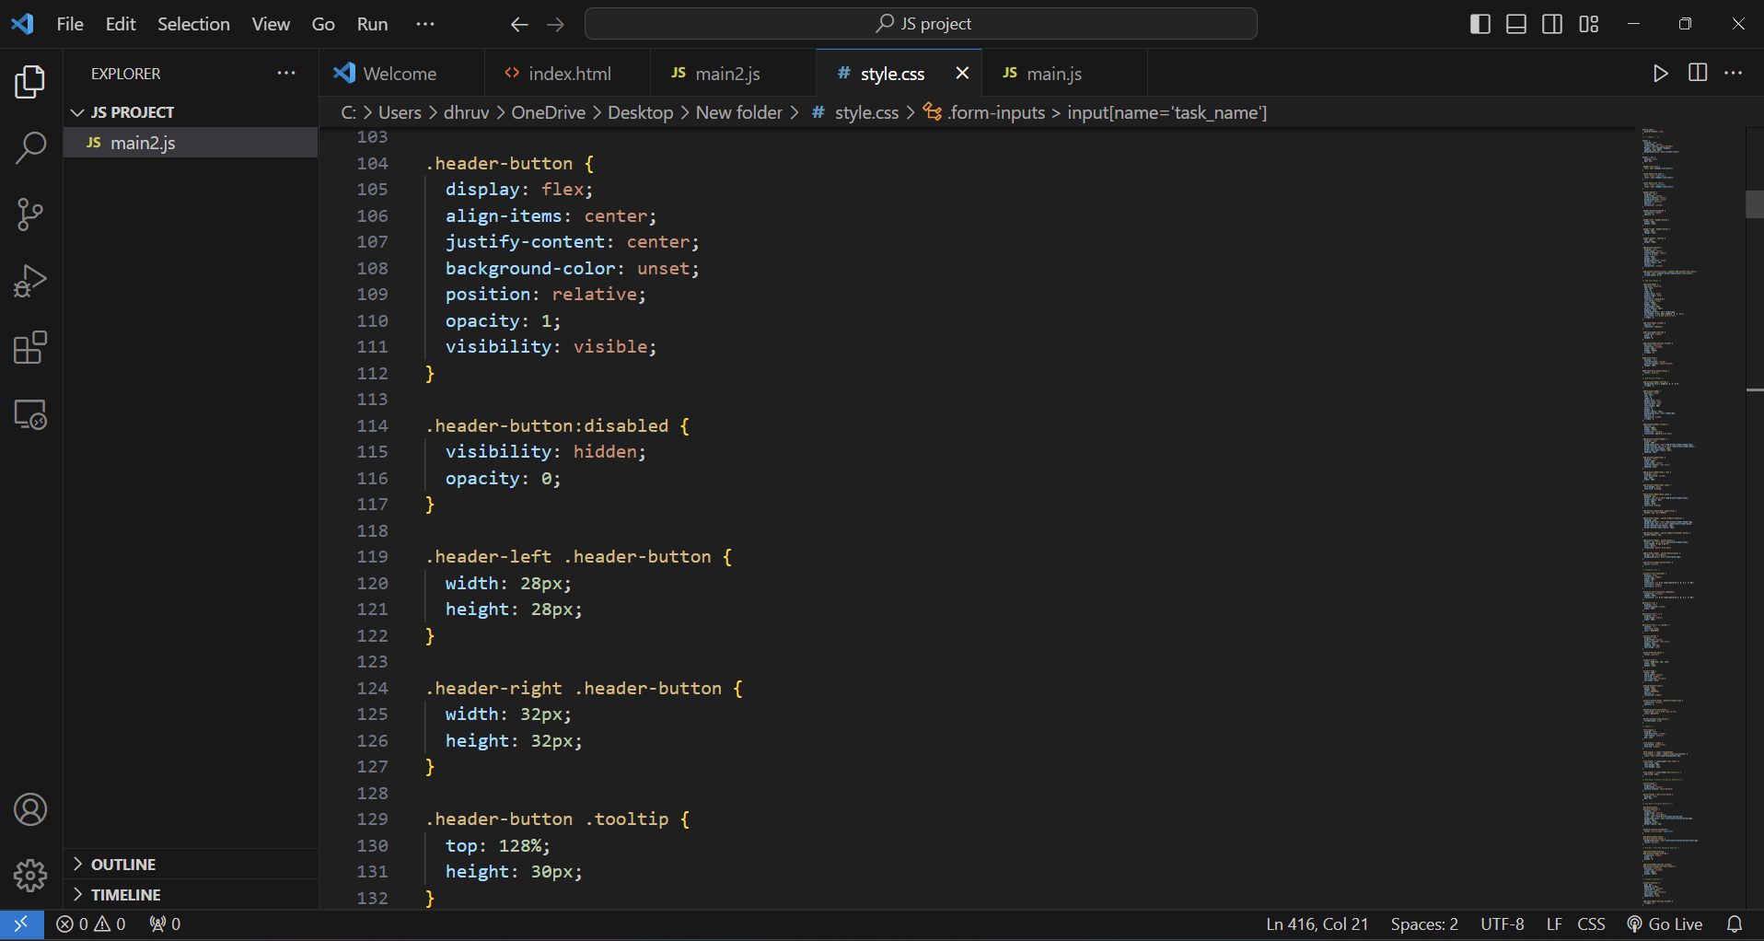
Conti….
2. CSS files of landing page

Slide 7
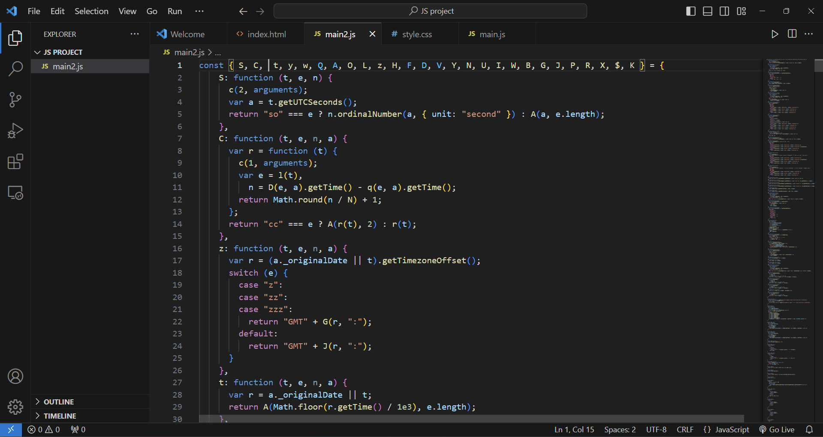
Conti...
3. Javascript DOM

Slide 8
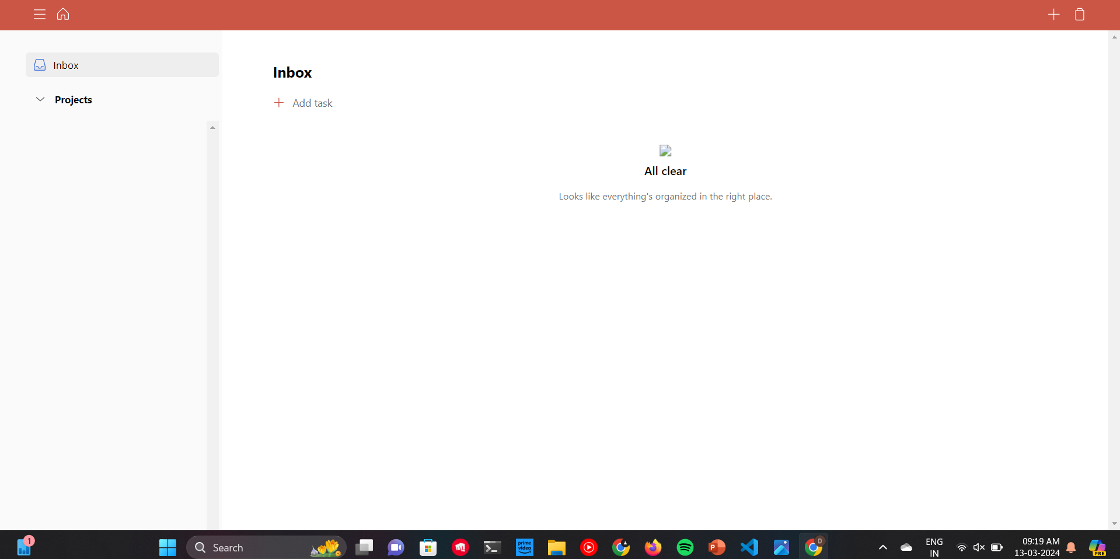
HOME PAGE

Slide 9
Conclusion/Theme Plan
Conclusion : In conclusion, the development of a task management app offers a promising solution to address the challenges faced by individuals and teams in managing their workload effectively. By leveraging innovative frontend technologies and design principles, such an app can provide users with a centralized, intuitive, and customizable platform for organizing, prioritizing, and tracking tasks.
Theme : The theme of the task management app revolves around efficiency, organization, and empowerment. At its core, the app aims to streamline workflows, enhance productivity, and foster collaboration in both personal and professional settings. With a focus on empowering users to take control of their tasks, the app provides intuitive features that facilitate effective prioritization, scheduling, and tracking of tasks. Through its user-centric design and customizable options, it adapts to the unique needs and preferences of individuals and teams, enabling them to work more efficiently and achieve their goals with confidence. By harnessing the capabilities of modern technology, the app serves as a valuable tool for navigating the complexities of the digital age, empowering users to manage their workload effectively and unlock their full potential.

Slide 10
References
https://www.w3schools.com/js/js_htmldom.asp
https://www.geeksforgeeks.org/dom-document-object-model/
https://youtu.be/7zcXPCt8Ck0?si=yjb5TJ3RoK8n3XoJ
https://www.freecodecamp.org/news/an-introduction-to-the-javascript-dom-512463dd62ec/

Slide 11
Thanks...

